Slide 1
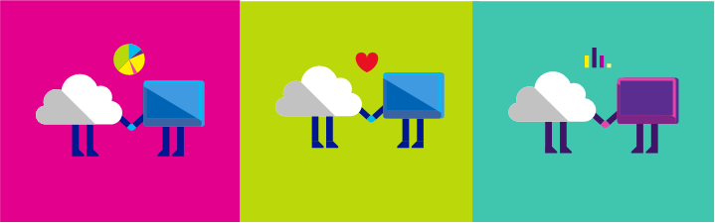

Get Connected!
Wi-Fi Network: MSFTGUEST
Passcode: msevent811hj

Slide 2
Day 2 – June 5, 2018 (Lake of the Woods I & II)
Time | Speaker | Topic
9:00 AM | Adam Grocholski | Platform Services
11:00 AM | Break
11:15 AM | Mark Ingram | Operational Readiness
12:30 PM | Labs/Lunch/Networking
1:30 PM | Mark Ingram | DevOps
2:45 PM | Break
3:00 PM | Mark Ingram | Making it Real with Practical Application
4:00 PM | Mark Ingram | Wrap-Up/Closing Remarks

Slide 3
Design Solutions by using Platform Services – Part 1
https://www.microsoft.com/handsonlabs

Slide 4
Design Solutions by using Platform Services
Design for Artificial Intelligence Services
Design for IoT
Design messaging solution architectures
Design for media service solutions
Notes:
Design for Artificial Intelligence Services
Determine when to use the appropriate Cognitive Services, Azure Bot Service, Azure Machine Learning, and other categories that fall under cognitive AI
Design for IoT
Determine when to use Stream Analytics, IoT Hubs, Event Hubs, real-time analytics, Time Series Insights, IoT Edge, Notification Hubs, Event Grid, and other categories that fall under IoT
Design messaging solution architectures
Design a messaging architecture; determine when to use Azure Storage Queues, Azure Service Bus, Azure Event Hubs, Event Grid, Azure Relay, Azure Functions, and Azure Logic Apps;
design a push notification strategy for Mobile Apps;
design for performance and scale
Design for media service solutions
Define solutions using Azure Media Services, video indexer, video API, computer vision API, preview, and other media related services

Slide 5
Design for Artificial Intelligence Services
Notes:
Design for Artificial Intelligence Services
Determine when to use the appropriate Cognitive Services, Azure Bot Service, Azure Machine Learning, and other categories that fall under cognitive AI

Slide 6
Design for Artificial Intelligence Services
Cognitive Services
Azure Bot Service
Azure Machine Learning

Slide 7


Cognitive Services
Vision
Computer Vision
Custom Vision Service
Content Moderator
Emotion API
Face API
Video Indexer
Speech
Bing Speech Service
Custom Speech Service
Speaker Recognition
Translator Speech
Language
Bing Spell Check
Language Understanding Intelligent Service (LUIS)
Linguistics Analysis
Text Analytics
Translator Text
Web Language Model
Knowledge
Custom Decision Service
QnA Maker
Knowledge Exploration
Entity Linking
Academic Knowledge
Search
Bing Web Search
Bing Custom Search
Bing Autosuggest
Bing News Search
Bing Video Search
Bing Entity Search
Bing Image Search
Notes:
Microsoft Cognitive Services (formerly Project Oxford) are a set of APIs, SDKs and services available to developers to make their applications more intelligent, engaging and discoverable. Microsoft Cognitive Services expands on Microsoft’s evolving portfolio of machine learning APIs and enables developers to easily add intelligent features into their applications.
Let me give two examples of projects my colleagues and I have built:
Learn to read (language identification, speech to text, language translation, text to speech)
Weapon detection (custom vision service)

Slide 8
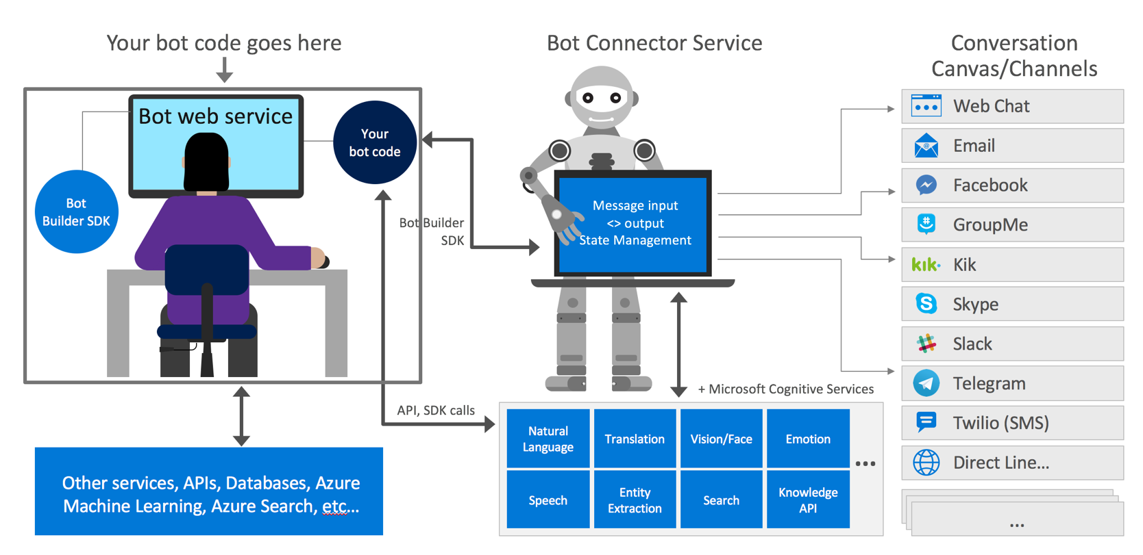
Azure Bot Service
Notes:
What is a bot?
A bot is an app that users interact with in a conversational way using text, graphics (cards), or speech. It may be a simple question and answer dialog, or a sophisticated bot that allows people to interact with services in an intelligent manner using pattern matching, state tracking and artificial intelligence techniques well-integrated with existing business services.
Azure Bot Service provides tools to build, test, deploy, and manage intelligent bots all in one place. Through the modular and extensible framework provided by the SDK, developers can leverage templates to create bots that provide speech, language understanding, question and answer, and more.

Slide 9
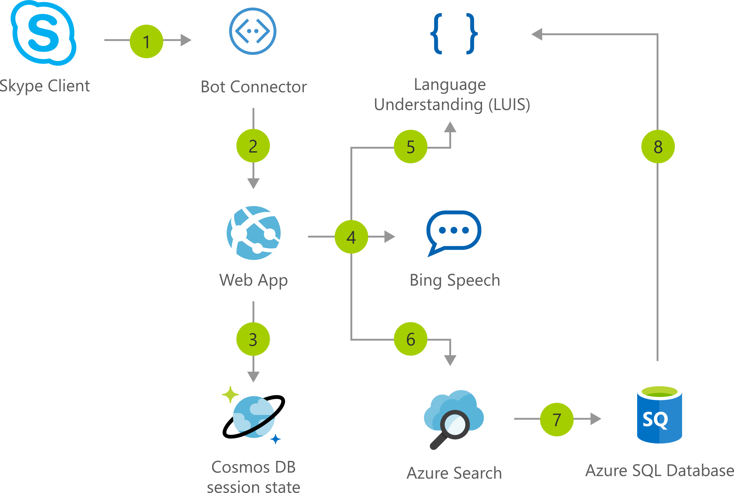
Interactive voice response bot
Notes:
Skype Client - User initiates call
Bot Connector + Skype Calling Channel - Routes calls from Skype to the bot
Azure App Services - Hosts the bot application, which manages logic and API calls
Cosmos DB - Stores bot state and event logs
Bing Speech Service - Processes speech-to-text
LUIS (Language Understanding Intelligent Service) - Extracts intent and entities from text
Azure Search - Indexes the product catalog for product-query matching
Azure SQL - Stores product and order data

Slide 10
Azure Machine Learning
Machine Learning Services
Built with open source tools
Jupyter Notebook, Apache Spark, Docker, Kubernetes, Python, Conda
Workbench
Experimentation Service
Model Management Service
Libraries for Apache Spark (MMLSpark Library)
Visual Studio Code Tools for AI
TRAIN & DEPLOY OPTIONS
AZURE
Spark
SQL Server
Virtual machines
GPUs
Container services
AI dev /
data scientist
workstation
CPU/GPU
Experimentation and Model Management
ON-PREMISES
SQL Server
Machine Learning Server
Notebooks
IDEs
Azure Machine Learning Workbench
EDGE COMPUTING
Azure IoT Edge
Notes:
What is Machine Learning?
Machine learning is a data science technique that allows computers to use existing data to forecast future behaviors, outcomes, and trends. Using machine learning, computers learn without being explicitly programmed.
Forecasts or predictions from machine learning can make apps and devices smarter.
When you shop online, machine learning helps recommend other products you might like based on what you've purchased.
When your credit card is swiped, machine learning compares the transaction to a database of transactions and helps detect fraud.
What is Azure Machine Learning?
Azure Machine Learning is an integrated, end-to-end data science and advanced analytics solution. It enables data scientists to prepare data, develop experiments, and deploy models at cloud scale.
The main components of Azure Machine Learning are:
Azure Machine Learning Workbench
Azure Machine Learning Experimentation Service
Azure Machine Learning Model Management Service
Microsoft Machine Learning Libraries for Apache Spark (MMLSpark Library)
Visual Studio Code Tools for AI
Together, these applications and services help significantly accelerate your data science project development and deployment.
Azure ML Workbench
Azure Machine Learning Workbench is a desktop application plus command-line tools, supported on both Windows and macOS. It allows you to manage machine learning solutions through the entire data science life cycle:
Data ingestion and preparation
Model development and experiment management
Model deployment in various target environments
Azure ML Experimentation Service
The Experimentation Service handles the execution of machine learning experiments. It also supports the Workbench by providing project management, Git integration, access control, roaming, and sharing.
Azure ML Model Management Service
Model Management Service allows data scientists and dev-ops teams to deploy predictive models into a wide variety of environments. Model versions and lineage are tracked from training runs to deployments. Models are stored, registered, and managed in the cloud.
MMLSpark Library
The MMLSpark(Microsoft Machine Learning Library for Apache Spark) is an open-source Spark package that provides deep learning and data science tools for Apache Spark. It integrates Spark Machine Learning Pipelineswith the Microsoft Cognitive Toolkit and OpenCV library. It enables you to quickly create powerful, highly scalable predictive, and analytical models for large image and text datasets.
VS Code Tools for AI
Visual Studio Code Tools for AI is an extension in Visual Studio Code to build, test, and deploy Deep Learning and AI solutions.

Slide 11
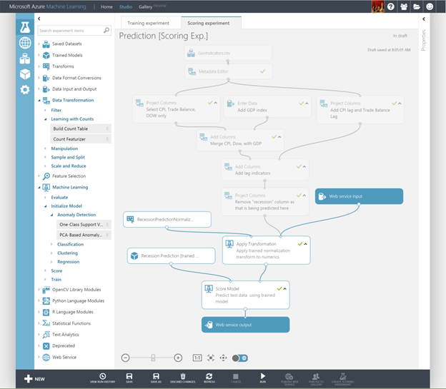
Azure Machine Learning
Machine Learning Studio
Integrated environment
Best-in-class algorithms
Deploy in minutes
Notes:
Azure ML Studio
Microsoft Azure Machine Learning Studio is a collaborative, drag-and-drop tool you can use to build, test, and deploy predictive analytics solutions on your data. Machine Learning Studio publishes models as web services that can easily be consumed by custom apps or BI tools such as Excel.
Integrated environment
Simple drag, drop, and connect browser-based workspace to data science
Best-in-class algorithms
Built-in collection of algorithms. 400+ R & CRAN packages, or use custom R or Python code
Deploy in minutes
Train and operationalize models with a single click, into fully functional web services
Re-train models and update the deployed web services through API’s

Slide 12
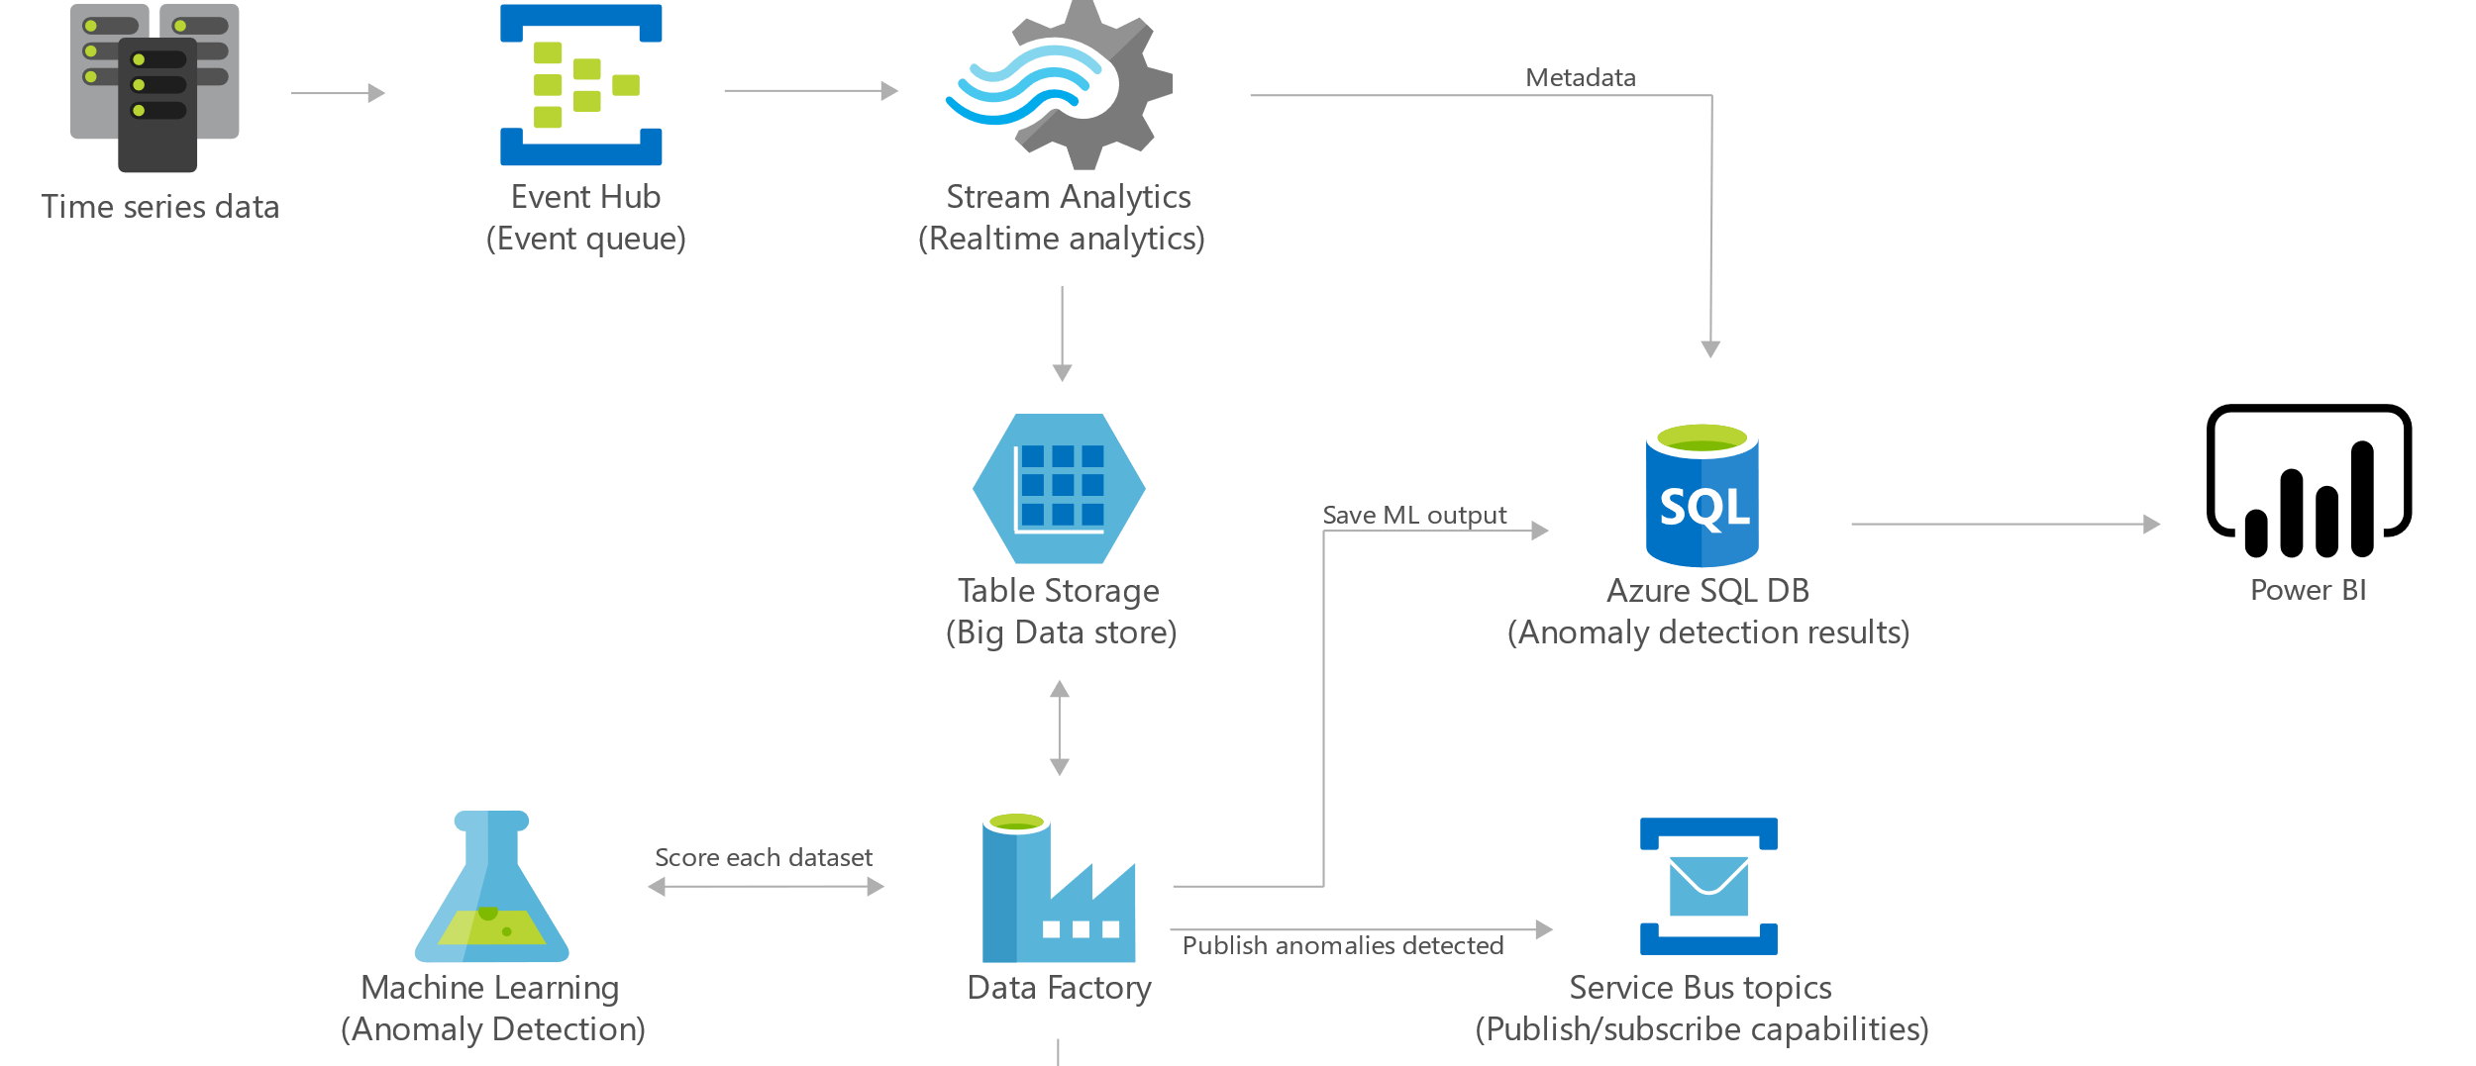
Anomaly detection

Slide 13
Design for IoT
Notes:
Design for IoT
Determine when to use Stream Analytics, IoT Hubs, Event Hubs, real-time analytics, Time Series Insights, IoT Edge, Notification Hubs, Event Grid, and other categories that fall under IoT

Slide 14
Design for IoT
IoT Hub
Stream Analytics
Time Series Insights
IoT Edge
Event Grid
Event Hub
Notification Hubs

Slide 15

IoT Hub
Establish bi-directional communication with billions of IoT devices
Authenticate per device for security-enhanced IoT solutions
Register devices at scale with IoT Hub Device Provisioning Service
Manage your IoT devices at scale with device management
Notes:
IoT Hub is a managed service, hosted in the cloud, that acts as a central message hub for bi-directional communication between your IoT application and the devices it manages. You can use Azure IoT Hub to build IoT solutions with reliable and secure communications between millions of IoT devices and a cloud-hosted solution backend. You can connect virtually any device to IoT Hub.
IoT Hub supports communications both from the device to the cloud and from the cloud to the device. IoT Hub supports multiple messaging patterns such as device-to-cloud telemetry, file upload from devices, and request-reply methods to control your devices from the cloud. IoT Hub monitoring helps you maintain the health of your solution by tracking events such as device creation, device failures, and device connections.
IoT Hub's capabilities help you build scalable, full-featured IoT solutions such as managing industrial equipment used in manufacturing, tracking valuable assets in healthcare, and monitoring office building usage.

Slide 16

Stream Analytics
Instantly analyze data from all your IoT devices and gateways
Develop massively parallel Complex Event Processing (CEP) pipelines with simplicity
Start in seconds, scale instantly, pay per job
Build real-time dashboards in minutes
Enterprise grade availability, auditing and support
Notes:
Azure Stream Analytics is an event-processing engine that allows you to examine high volumes of data streaming from devices. Incoming data can be from devices, sensors, web sites, social media feeds, applications, and more. It also supports extracting information from data streams, identifying patterns, and relationships. You can then use these patterns to trigger other actions downstream, like alerts, feed information to a reporting tool, or store it for later use.
Following are some examples where Azure Stream Analytics can be used:
Internet of Things(IoT) Sensor fusion and real-time analytics on device telemetry
Web logs/clickstream analytics
Geospatial analytics for fleet management and driverless vehicles
Remote monitoring and predictive maintenance of hi-value assets
Real-time analytics on Point of Sale data for inventory control and anomaly detection

Slide 17

Time Series Insights
Find actionable insights in seconds
Start in seconds, scale in minutes
Create a global view of your IoT-scale data
Apply Time Series Insights to your apps and solutions
Access enterprise-grade security and support
Notes:
Time Series Insights is built for storing, visualizing, and querying large amounts of time series data, such as that generated by IoT devices. If you want to store, manage, query, or visualize time series data in the cloud, Time Series Insights is likely right for you.
Time Series Insights has four key jobs:
First, it's fully integrated with cloud gateways like Azure IoT Hub and Azure Event Hubs. It easily connects to these event sources and parses JSON from messages and structures that have data in clean rows and columns. It joins metadata with telemetry and indexes your data in a columnar store.
Second, Time Series Insights manages the storage of your data. To ensure data is always easily accessible, it stores your data in memory and SSD’s for up to 400 days. You can interactively query billions of events in seconds – on demand.
Third, Time Series Insights provides out-of-the-box visualization via the TSI explorer.
Fourth, Time Series Insights provides a query service, both in the TSI explorer and by using APIs that are easy to integrate for embedding your time series data into custom applications.

Slide 18
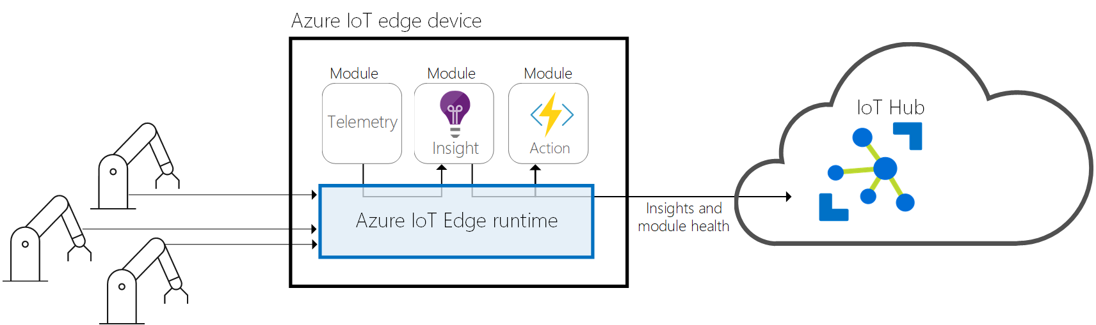
IoT Edge
Extend cloud intelligence to edge devices
Run artificial intelligence at the edge
Perform edge analytics
Deploy IoT solutions from cloud to edge
Manage devices centrally from the cloud
Operate with offline and intermittent connectivity
Enable real-time decisions
Connect new and legacy devices
Reduce bandwidth costs
Notes:
Azure IoT Edge moves cloud analytics and custom business logic to devices so that your organization can focus on business insights instead of data management. Enable your solution to truly scale by configuring your IoT software, deploying it to devices via standard containers, and monitoring it all from the cloud.
Analytics drives business value in IoT solutions, but not all analytics needs to be in the cloud. If you want a device to respond to emergencies as quickly as possible, you can perform anomaly detection on the device itself. Similarly, if you want to reduce bandwidth costs and avoid transferring terabytes of raw data, you can perform data cleaning and aggregation locally. Then send the insights to the cloud.
Azure IoT Edge is made up of three components:
IoT Edge modules are containers that run Azure services, 3rd party services, or your own code. They are deployed to IoT Edge devices and execute locally on those devices.
The IoT Edge runtime runs on each IoT Edge device and manages the modules deployed to each device.
A cloud-based interface enables you to remotely monitor and manage IoT Edge devices.

Slide 19
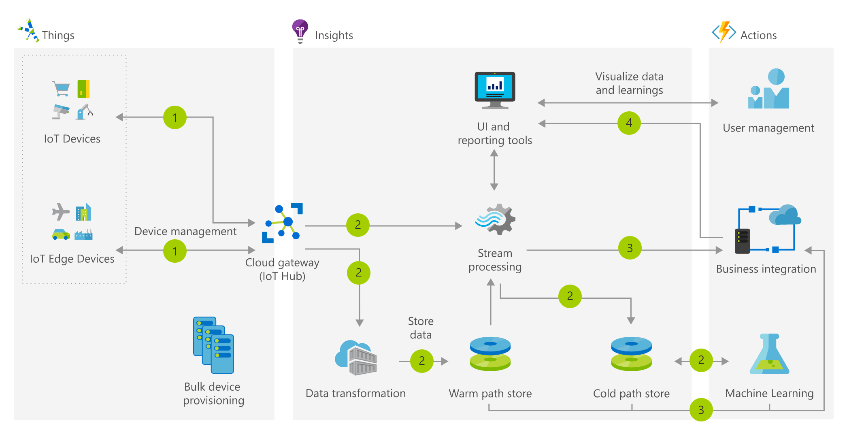
Notes:
1 Devices send telemetry records or events to the cloud gateway.
2 The following steps happen in parallel: Stream processing and rules evaluation is done for device telemetry records and events. Device telemetry data is transformed (if needed). Device data telemetry is stored.
3 Business process integration (such as email or CRM) is executed.
4 Device information is visualized and displayed in the UI.

Slide 20
Azure IoT
Azure IoT Edge Securely distribute cloud intelligence locally, and at scale
Azure IoT Hub IoT cloud gateway
Azure IoT Suite Preconfigured solutions for common scenarios
Remote Monitoring | Predictive Maintence | Connected Factory
Azure Time Series Insights Explore and analyze time series data fast, and at scale
Microsoft IoT Central Fully managed IoT SaaS
Azure IoT Security partners
IoT security auditors program

Slide 21
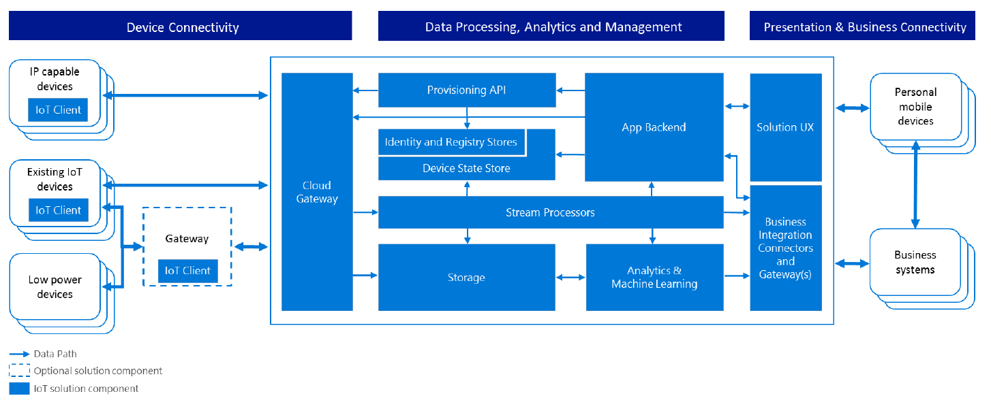
IoT Solution Architecture

Slide 22
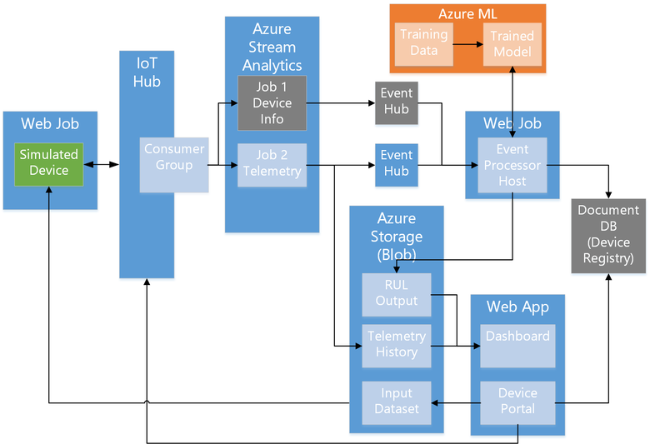
Predictive maintenance architecture

Slide 23
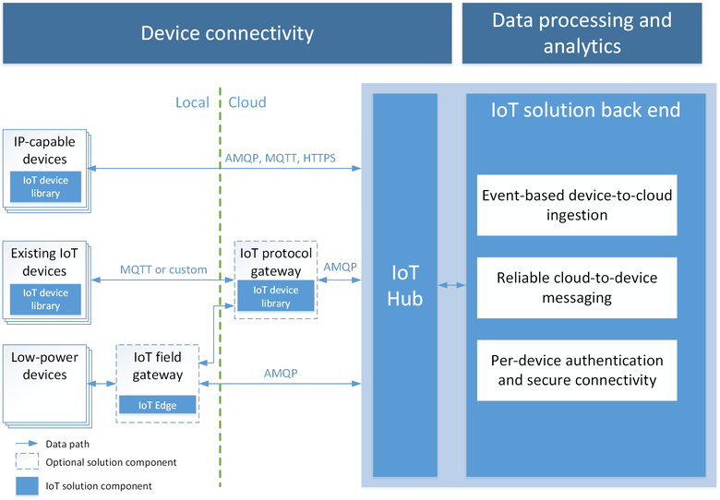
Azure IoT Hub

Slide 24
Design messaging solution architectures
Notes:
Design messaging solution architectures
Design a messaging architecture; determine when to use Azure Storage Queues, Azure Service Bus, Azure Event Hubs, Event Grid, Azure Relay, Azure Functions, and Azure Logic Apps;
design a push notification strategy for Mobile Apps;
design for performance and scale

Slide 25
Design messaging solution architectures
Storage Queues
Service Bus Messaging (Queues, Topics & Subscriptions)
Service Bus Relay
Event Hubs
Event Grid
Notes:
Storage Queues
Azure Queue storage is a service for storing large numbers of messages that can be accessed from anywhere in the world via authenticated calls using HTTP or HTTPS. A single queue message can be up to 64 KB in size, and a queue can contain millions of messages, up to the total capacity limit of a storage account.
Event Grid
Azure Event Grid allows you to easily build applications with event-based architectures. You select the Azure resource you would like to subscribe to, and give the event handler or WebHook endpoint to send the event to. Event Grid has built-in support for events coming from Azure services, like storage blobs and resource groups. Event Grid also has custom support for application and third-party events, using custom topics and custom webhooks.

Slide 26
Design messaging solution architectures
Storage Queues
Service Bus Messaging
Service Bus Relay
Event Hubs
Event Grid
Message queue
Message broker
Connection bridging
Data streaming
Event distribution

Slide 27

Service bus
PaaS with no Infrastructure management
Relay capabilities to build hybrid apps
Supports AMQP and common protocols such as HTTP
Contains Event Hub, a cloud scale telemetry ingress service.
Notes:
What is Azure Service Bus?
Microsoft Azure Service Bus is a fully managed enterprise integration message broker. Service Bus is most commonly used to decouple applications and services from each other, and is a reliable and secure platform for asynchronous data and state transfer. Data is transferred between different applications and services using messages. A message is in binary format, which can contain JSON, XML, or just text.
Some common messaging scenarios are:
Messaging: transfer business data, such as sales or purchase orders, journals, or inventory movements.
Decouple applications: improve reliability and scalability of applications and services (client and service do not have to be online at the same time).
Topics and subscriptions: enable 1:n relationships between publishers and subscribers.
Message sessions: implement workflows that require message ordering or message deferral.

Slide 28
Service Bus Queue
S
R
S
Queue
R
S
R
Point to point communication
FIFO order guarantee
Supports Batch Receive and Batch Send
Notes:
Queues offer First In, First Out (FIFO) message delivery to one or more competing consumers. That is, messages are typically expected to be received and processed by the receivers in the order in which they were added to the queue, and each message is received and processed by only one message consumer.
Benefits
Temporal decoupling - the producers (senders) and consumers (receivers) do not have to be sending and receiving messages at the same time, because messages are stored durably in the queue. Furthermore, the producer does not have to wait for a reply from the consumer in order to continue to process and send messages.
Load leveling - enables producers and consumers to send and receive messages at different rates.
Loose coupling - because producers and consumers are not aware of each other, a consumer can be upgraded without having any effect on the producer.

Slide 29
Service Bus Topic
S
R
Subs
Topic
S
R
R
R
S
R
One to many broadcasting scenarios
Filter messages
Use ReceiveBatch() or ReceiveBatchAsync() to receive a batch of messages
Notes:
In contrast to queues, in which each message is processed by a single consumer, topics and subscriptionsprovide a one-to-many form of communication, in a publish/subscribe pattern. Useful for scaling to very large numbers of recipients, each published message is made available to each subscription registered with the topic.
Messages are sent to a topic and delivered to one or more associated subscriptions, depending on filter rules that can be set on a per-subscription basis.
The subscriptions can use additional filters to restrict the messages that they want to receive.
Messages are sent to a topic in the same way they are sent to a queue, but messages are not received from the topic directly. Instead, they are received from subscriptions. A topic subscription resembles a virtual queue that receives copies of the messages that are sent to the topic. Messages are received from a subscription identically to the way they are received from a queue.

Slide 30
Connectivity for Hybrid Applications
Azure Relay
Hybrid connections and WCF Relay are part of the Azure Relay service
Communicate with on-premises resources without opening a firewall port
Hybrid Connections support multi-platform scenarios.
Hybrid Connections can be used to connect to any TCP port including SQL DB’s and Web API’s.
WCF Relay can communicate with WCF services and .NET Framework only.
Notes:
The Azure Relay service facilitates hybrid applications by enabling you to securely expose services that reside within a corporate enterprise network to the public cloud, without having to open a firewall connection, or require intrusive changes to a corporate network infrastructure. Relay supports a variety of different transport protocols and web services standards.
Windows Communication Foundation
EXAM:EXPRESSROUTE IS PRIVATE CONNECTION.
OFTEN ORGS USE VPN AS WELL—FASTER TO SET UP, CAN FAIL OVER FROM EXPRESSROUTE TO VPN
EXAM: WCF RELAY-.NET FRAMEWORK, OTHERWISE, EXPRESSROUTE OR ?
RRAS CAN BE A VPN ENDPOINT TO GO TO AZURE
DATACENTER TO DATACENTER—CAN USE VPN
POINT TO SITE=TO DISCRETE PARTS OF AZURE

Slide 31
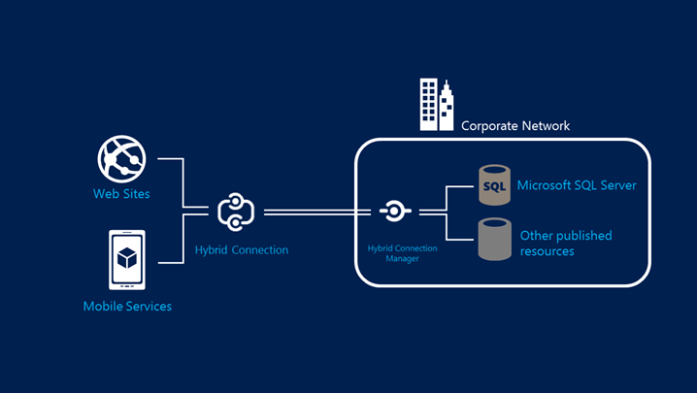
Hybrid Connections Architecture
Notes:
HYBRID CONNECTIONS CONNECT TO APP SERVICES, INCLUDING FUNCTIONS, MOBILE APIS
HYBRID CONNECTIONS ARE REALLY SERVICE BUS RELAYS UNDER THE HOOD

Slide 32
Event Hub
Ingest messages at scale at high throughput, high volume and low latency
Typical use cases are IOT and enterprise logging
Messages are durable for 7 days
No enterprise messaging features such as dead letter queue
Notes:
Azure Event Hubs is a highly scalable data streaming platform and event ingestion service, capable of receiving and processing millions of events per second. Event Hubs can process and store events, data, or telemetry produced by distributed software and devices. Data sent to an event hub can be transformed and stored using any real-time analytics provider or batching/storage adapters
LARGE VOLUME WITH LOW LATENCY
DATA MUST BE OFFLOADED SOMEWHERE IF YOU CAN’T ACCESS IT WITHIN SEVEN DAYS

Slide 33
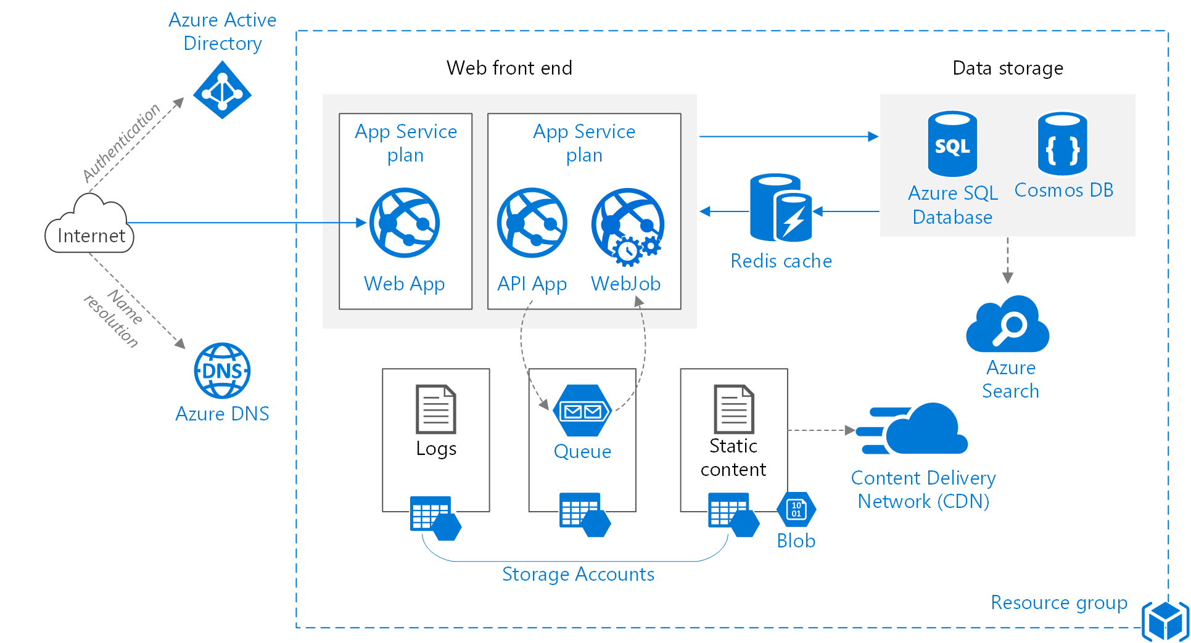
Web application architecture

Slide 34


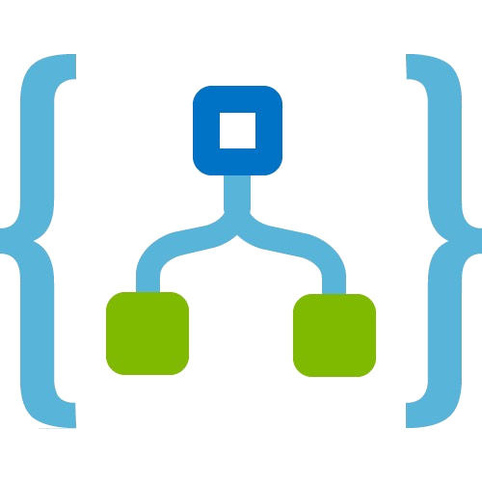




Serverless event-driven architecture
Functions
Machine Learning
Relational
API Management
Functions
Service Bus
Logic Apps
3rd Party
Event Grid
Functions
Functions
Cosmos DB
Cognitive Services
Blobs

Slide 35
Design for media service solutions
Notes:
Design for media service solutions
Define solutions using Azure Media Services, video indexer, video API, computer vision API, preview, and other media related services

Slide 36
Design for media service solutions
Encoding
Media Analytics
Streaming
Content Protection
Content Delivery Network (CDN)
Azure Media Player
Notes:
Encoding
Studio grade encoding enables:
Encoding to multiple formats
Scalable batch processing
Thumbnail, overlay, stitching, and clip generation
High-performance encoing
Web, professional, and broadcast workflow support
ISO- and CDSA-certified highly-secure encoding platform
Media Analytics
Extract advanced metadata using deep-learning based analysis to
Automatically generate standard caption files for your videos
Create smooth and stabilized time lapses from first-person videos
Detect motion, faces and emotion
Summarize videos
Moderate content
Streaming
Deliver content to virtually any device at scale
Just-in-time packaging to HLS, MPEG-DASH, and Smooth Streaming
Just-in-time AES encryption and PlayReady DRM technology
Direct integration with CDN
Scalability to handle all audience sizes
Dynamic manifest manipulation for trimming and rendition filtering
Full cloud DVR workflow capabilities
Content Protection
Deliver highly secure content
Secure content from cloud upload to playback
Use AES clear key and multi-DRM (PlayReady, Widevine, and FairPlay Streaming)
Simplify key management and allow dynamic encryption on the fly
Integrate with Active Directory or your own authentication system
Configure protection rules with simple APIs or web portal
Deliver highly-secure playback with native HTML5 or client SDKs for all device
CDN
Secure and reliable global content delivery and acceleration
Global coverage and massive scalability
Integrated into your Azure services, letting you scale in minutes
Simple setup and no commitment: pay-as-you-go
Azure Media Player
A single player for your content on multiple devices
Supports most popular screens and devices
Automatically chooses the best playback format
Easily integrates into web and app solutions
Lets you use familiar JavaScript API development
Includes automatic fallback for Flash and Silverlight
Gives you integrated content protection

Slide 37
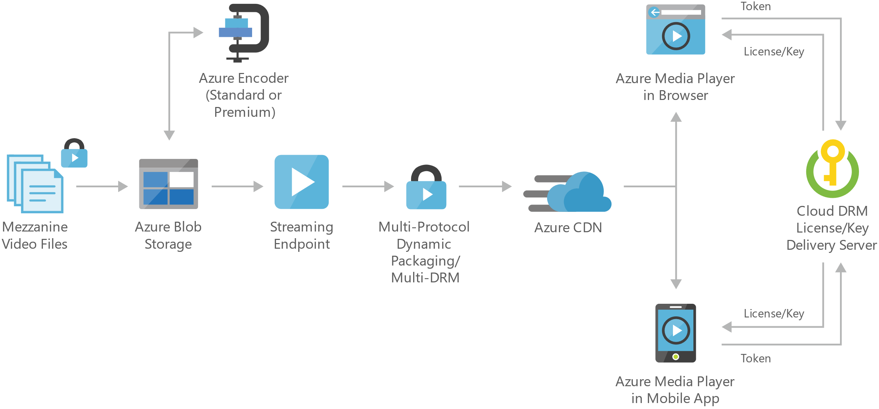
Video-on-demand digital media

Slide 38
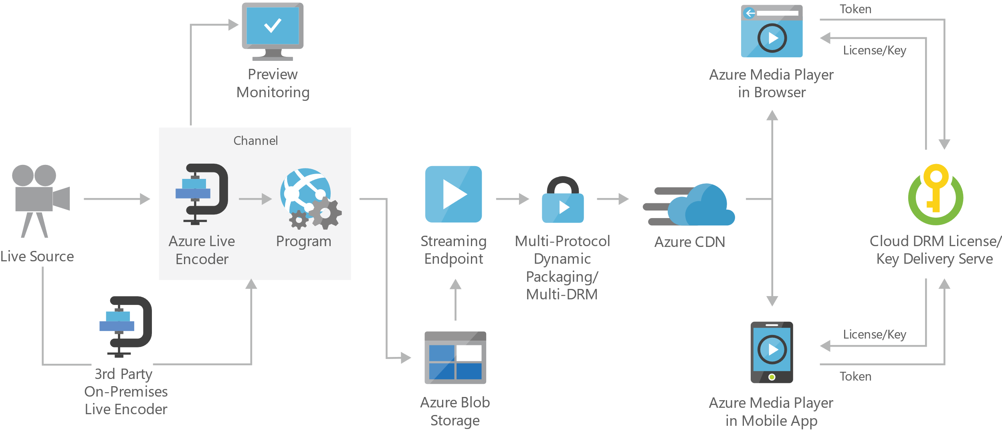
Live streaming digital media
Notes:
On-premises live encoder - Outputs the live source for ingest into the cloud as RTMP, MPEG-Transport Stream, or fragmented mp4 formats.
Preview monitoring - Provides the ability to preview and validate a live stream before further processing and delivery.
Streaming endpoint - Represents a streaming service that can deliver content directly to a client player application, or to a content delivery network (CDN) for further distribution.
Multi-DRM - Delivers content securely using multi-DRM (PlayReady, Widevine, FairPlay Streaming) or AES clear key encryption.

Slide 39
Questions?

